Slide 1
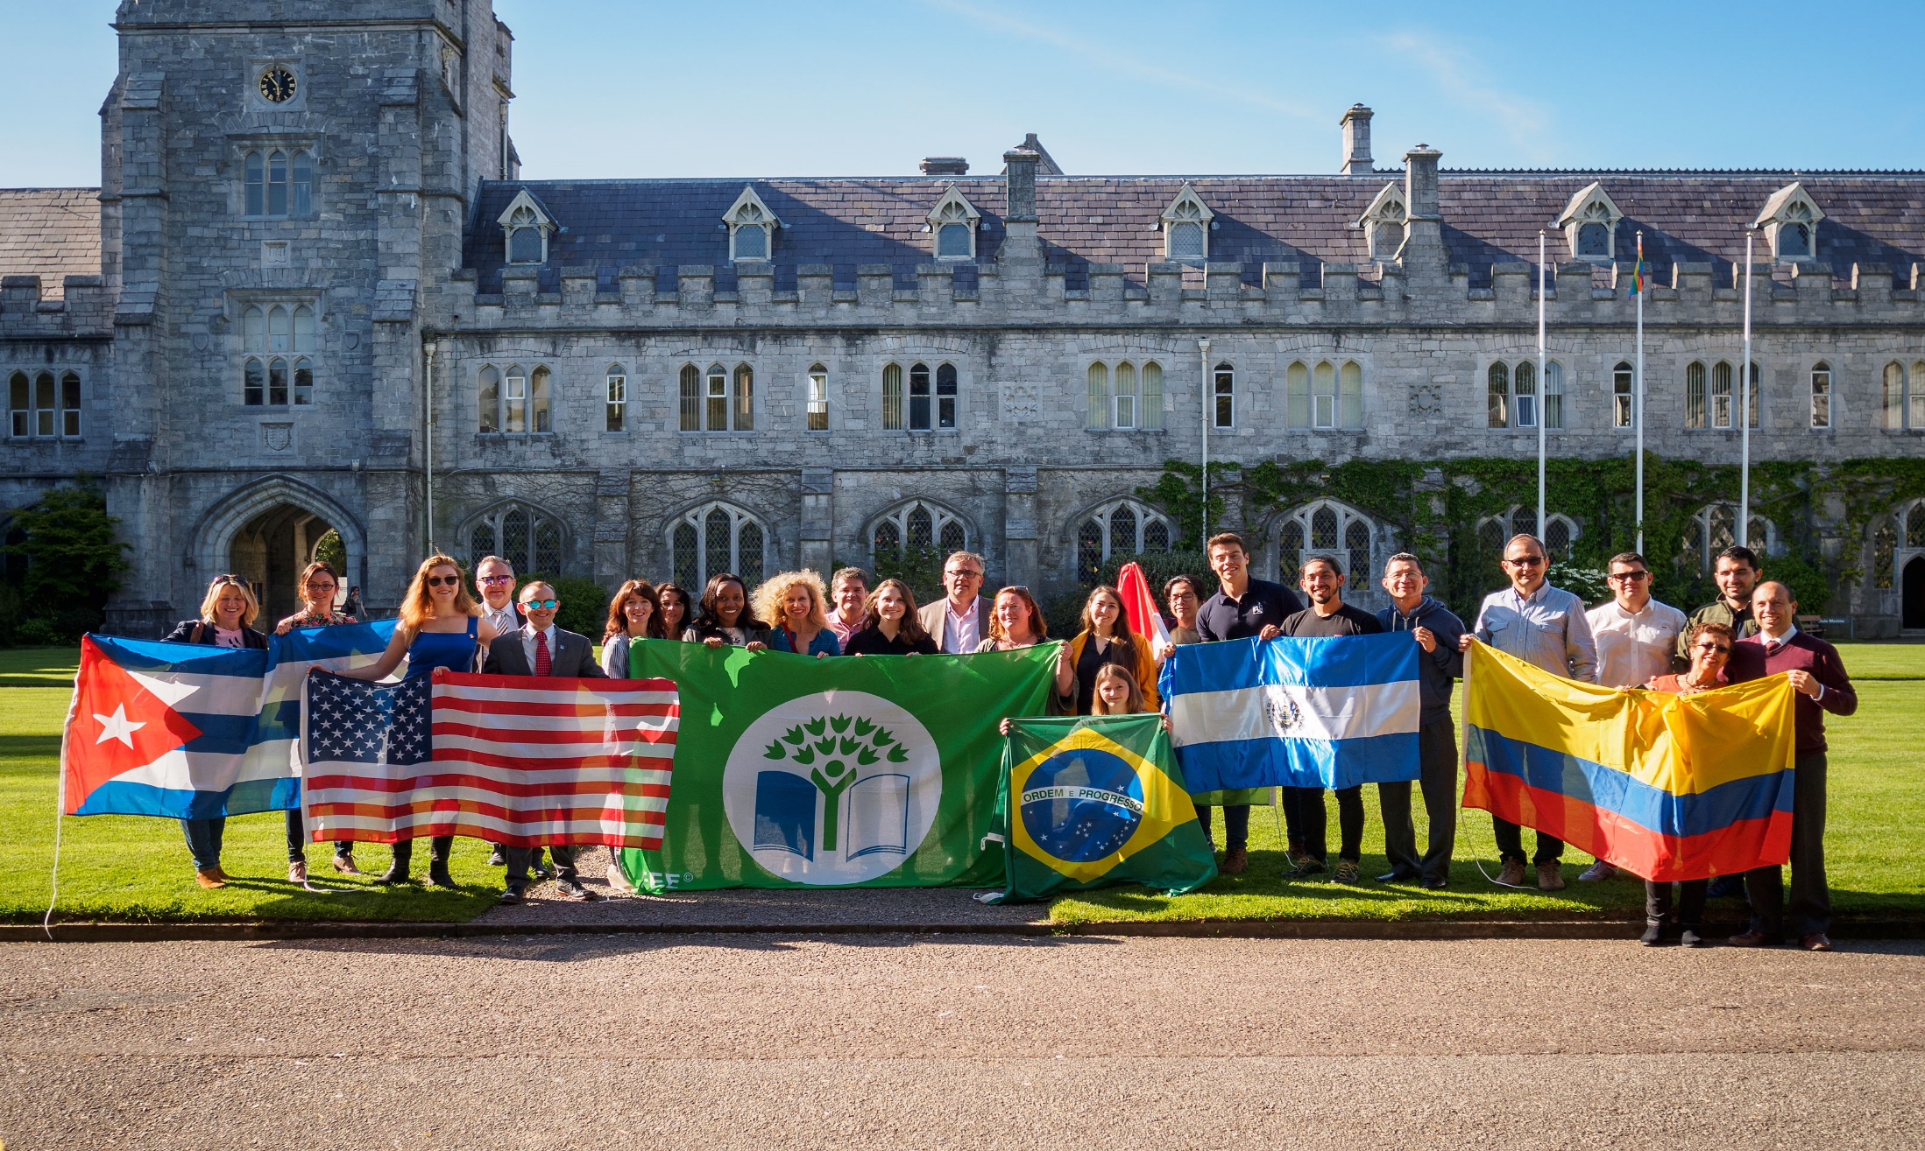
FEE EcoCampus

Slide 2
Foundation for Environmental Education
A non-profit, non governmental organisation based in Copenhagen, Denmark
Promoting Sustainable Development through
Environmental Education worldwide
An umbrella organisation with one member
organisation in each country
4 member organisations in 4 countries in 1981
98 member organisations in 77 countries in 2018
5 environmental education programmes
3
Notes:
AIM: Ensure young people have power to be the change for sustainability that our world needs by engaging them in fun, action-orientated and socially responsible learning.
Here, maybe say completely global, Tanzania 62, Montenegro was 63, Ukraine is no 64 (Never really know the exact amount) The Eco-Schools numbers can only be a snap shot of the actual numbers as the award ceremonies, the programme management as well as the school cycle vary from country to country (also depends when they update the figures in our database – Podio)
- Get new numbers from Bianca (or from our new broshure)

Slide 3
FEE programmes
Eco-Schools
Learning about Forests
Blue Flag
Young Reporters for the Environment
Green Key
FEE ECOCAMPUS
4
Notes:
FEEE (Foundation for Environmental Education in Europe):
established in 1981 out of a UN conference Blue Flag: adopted with the support of the European Commission in 1987
In 1994 the Eco-Schools and YRE programmes started LEAF was implemented as a FEE programme in 2000 and Green Key in 2003 In 2001 FEEE expanded outside Europe and changed its name to FEE 2012: FEE 30th anniversary. Blue Flag 25th anniversary 2014: YRE, Green Key and Eco-schools 20th anniversary 2015: LEAF 15th anniversary

Slide 4
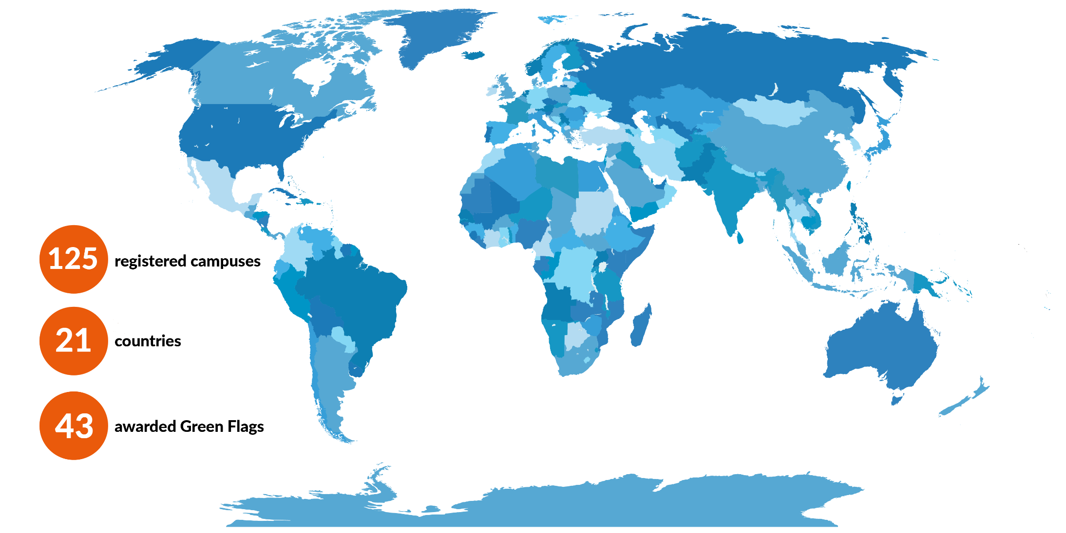
FEE EcoCampus
FEE ECOCAMPUS
2
Notes:
AIM: Ensure young people have power to be the change for sustainability that our world needs by engaging them in fun, action-orientated and socially responsible learning.
Here, maybe say completely global, Tanzania 62, Montenegro was 63, Ukraine is no 64 (Never really know the exact amount) The Eco-Schools numbers can only be a snap shot of the actual numbers as the award ceremonies, the programme management as well as the school cycle vary from country to country (also depends when they update the figures in our database – Podio)

Slide 5
What is FEE EcoCampus?
FEE EcoCampus is a multi-level educational award programme with the goal to help transform higher education institutions to work in alignment with the SDGs, and educate and empower students to become thought leaders and active citizens for change by engaging teachers, staff and students as well as the wider community.
FEE ECOCAMPUS

Slide 6
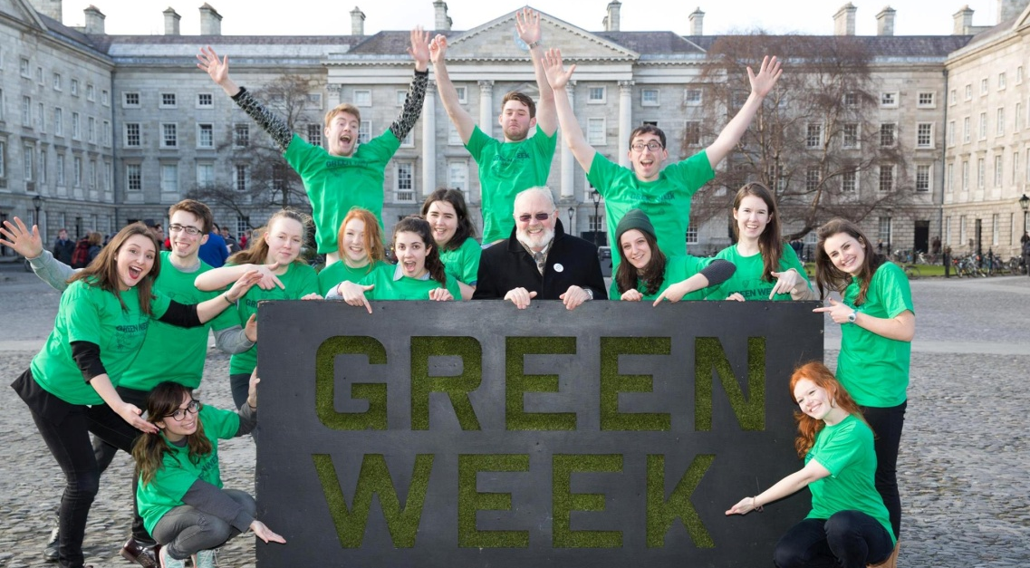
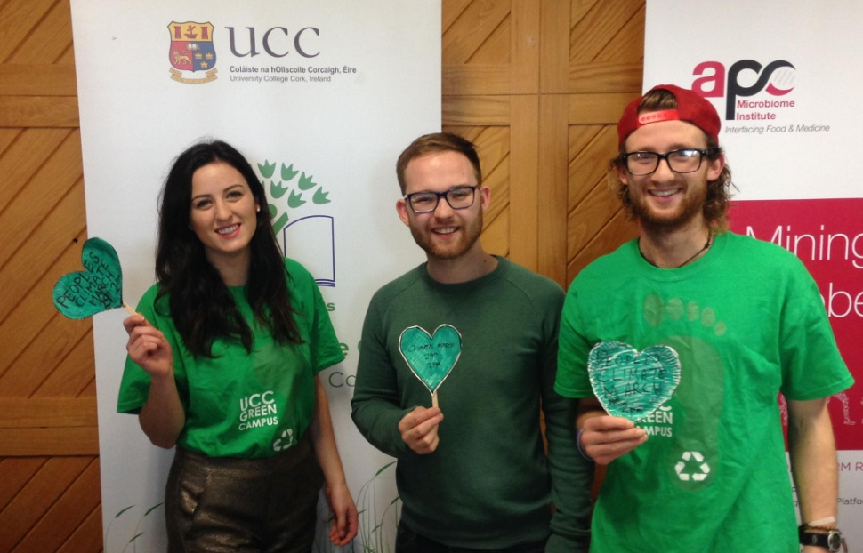
Strategies
Whole institution, all-inclusive, student-led participatory approach
Action-oriented curriculum
Quality and value-based sustainability education
Involvement of teachers, staff, students, and communities
FEE ECOCAMPUS

Slide 7
FEE EcoCampus History
2003
2010
2009
2008
2007
2004
Russia
Iceland
Russia awards its first Green Flag for a faculty
Univeristy College Cork in Ireland: the first university in the world to be awarded the Green Flag
Coláiste Dhúlaigh. Denmark awards a Teacher Training College with the Green Flag
Ireland
Portugal
Denmark
2012
The first FEE EcoCampus Alliance Meeting is held
Latvia
Slovenia
Serbia
2013
2014
2015
2016
2017
2018
2019
Croatia
Formal FEE EcoCampus working group is set up
Pilot projects Uganda, Malaysia
Puerto Rico
USA and England launch the FEE EcoCampus
Spain
Singapore
Bermuda
The First International Meeting of FEE EcoCampus is held in Lisbon, several other countries join via live stream
FEE EcoCampus is one of the tertiary education sustainability networks that forms a Global Alliance
Cork University Hospital (CUH) in Ireland is the first hospital in the world to be awarded the Green Flag.
FEE ECOCAMPUS

Slide 8
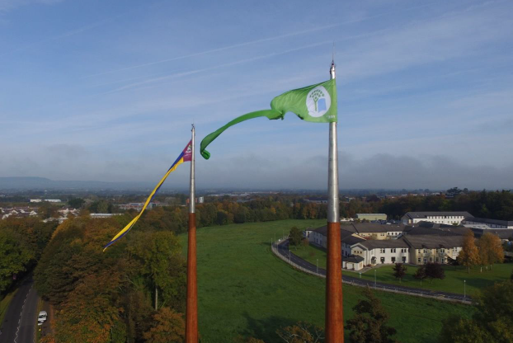
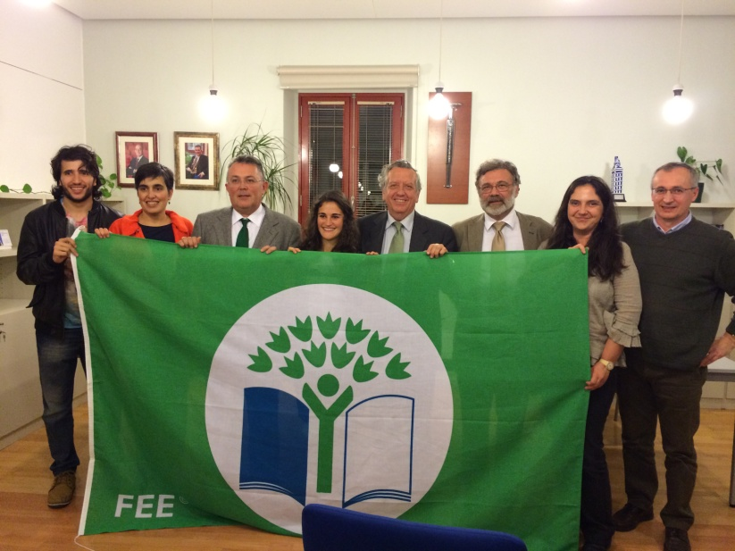
How does FEE EcoCampus work?
Registration
Implementation of the FEE Eco-Campus Programme
Applying for the International Green Flag Award
Award Renewal
Pre-Registration: forming the Eco Committee and completing a scoping exercise.
The Green Flag
FEE ECOCAMPUS

Slide 9
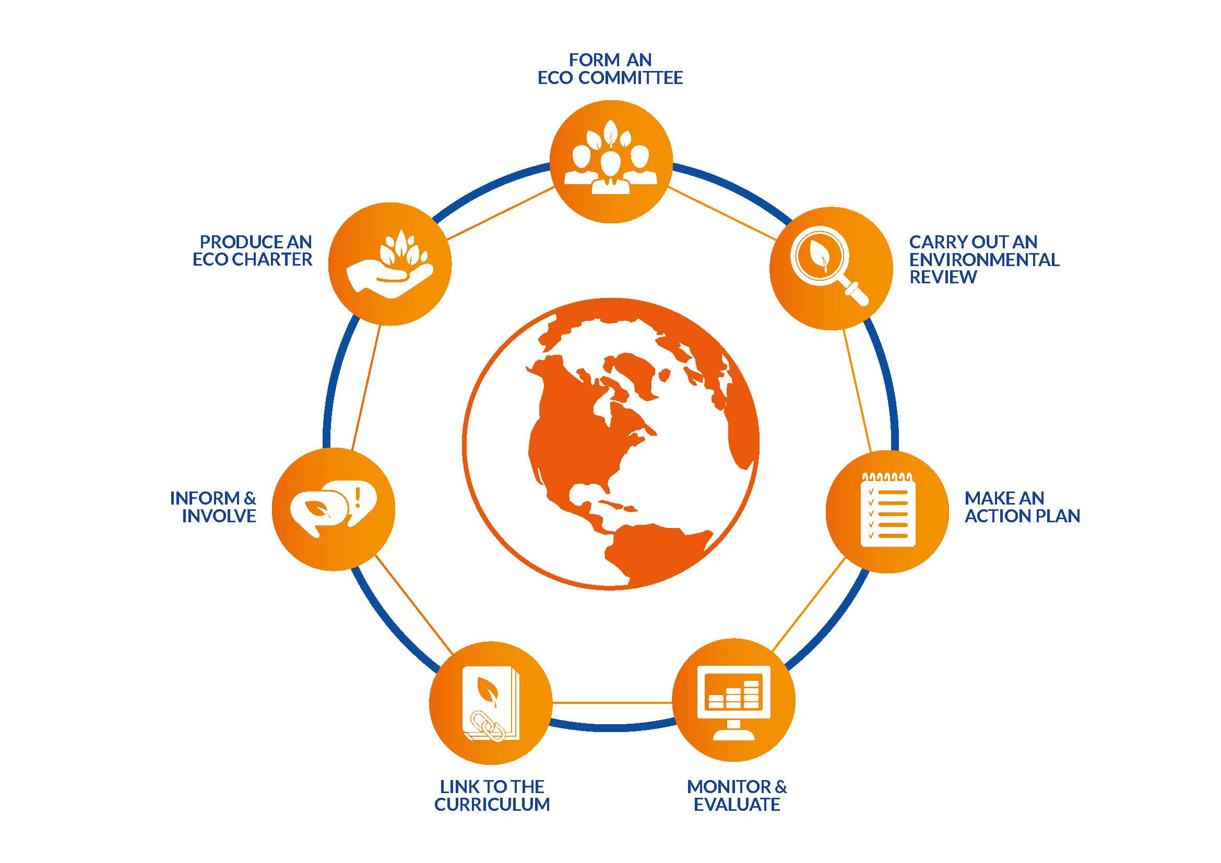
The Seven-Step Change Framework for continuous improvement!
FEE ECOCAMPUS

Slide 10
Whole Institutional Approach
Priority area # 2 in UNESCO GAP for ESD
Formal Curriculum
Learning and teaching
Self evaluation
Community links
Administrative, technical and economical organisational practice
Organisational culture and ethos, social and organisational
Involvement of students, teachers, staff, parents and community
Recognise grassroots processes – agents/champions of change
Enablers essential
FEE ECOCAMPUS
Model of the five strands for Whole Institutional Approach to ESD based on Shallcross (2003)
Notes:
UNESCO about ESD: “Education for Sustainable Development (ESD) is about enabling us to constructively and creatively address present and future global challenges and create more sustainable and resilient societies.”

Slide 11
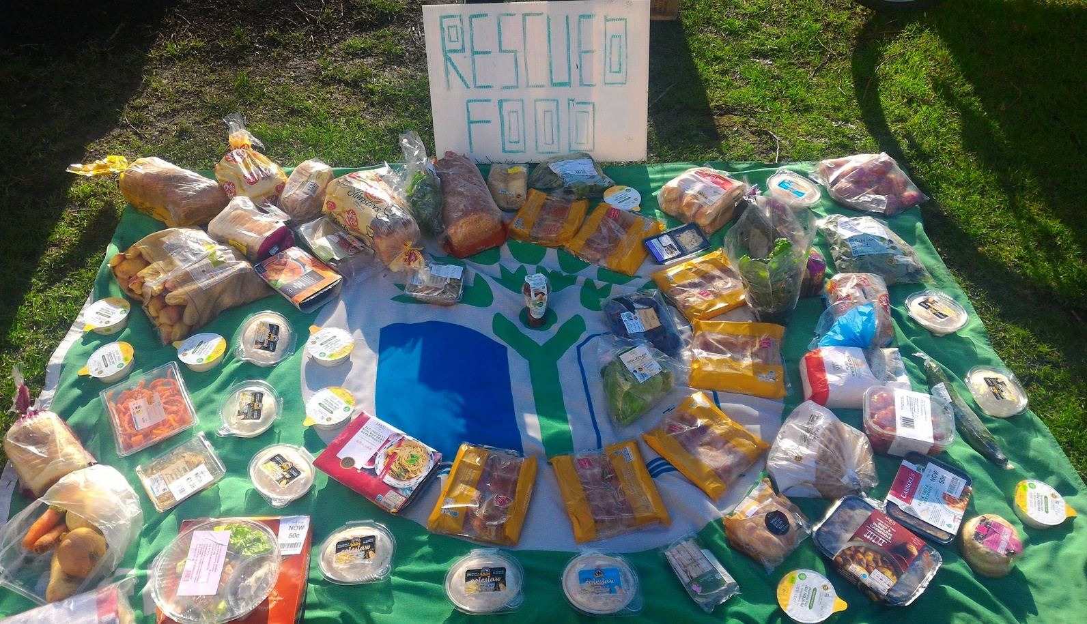
FEE EcoCampus is ESD in action
FEE EcoCampus is not an economic model to lower costs through efficiency, but also a humanistic model, that places the students and stakeholders at the centre of the process of change towards sustainability that is connected to the real issues in their communities.
FEE ECOCAMPUS
Notes:
UNESCO about ESD: “Education for Sustainable Development (ESD) is about enabling us to constructively and creatively address present and future global challenges and create more sustainable and resilient societies.”
In the example photo, we see how Trinity College Environmental Society campaigned against supermarket food waste, by providing ‘rescued’ food for free!

Slide 12
Benefits to the Environment
Integrate sustainability perspectives based on the four pillars of sustainability
Sustainability impacts of the campus are quantified so targets and performance indicators can be set
Improves waste management and resource use
Improves overall environmental performance
Lowers institutions carbon footprint
Benefits to the institute
Gain access to a wide network of campuses and people, and create linkages
Empowers students and staff to become leaders with positive impact
Encourages innovation and change
Prevents and reduces environmental impacts
Reduces associated costs
Good publicity
Improve rankings
Access new SDG related funding streams
Benefits to students and learning
Improves learning outcomes
Inspires sustainable choice making
Develops research skills via
-action plan development
-investigation
-setting targets
-monitoring and reporting
progress
Transferable skills to
workplace:
communication
facilitation
teamwork
committee servicing
Introduction to new topics
Curriculum links:
using data currently generated
investigative research
Problem based research
Benefits to local and wider community
Research helps to get the university and students involved with the city and community
Sets an example in the locality
Involves local groups and representatives facilitating shares of experience and best practice
Creates a network, linking activities to other projects in your country
FEE ECOCAMPUS

Slide 13
FEE EcoCampus & the National Operator Role
National Operator tasks
Pre-registration phase - Assistance with scoping report and setting up FEE EcoCampus Committee
Registration - Assists FEE EcoCampus Committee with scoping report and registers officially
National Eco Committee or Expert Panel
Practical help:
- see critical criteria
- provide connection to networks/people
- facilitate Environmental Reviews
- facilitate the Action Plan
Arrange Award! – send out application to assessment panel, collate results
Annual report for all Campuses to FEE Head Office each year
*
FEE ECOCAMPUS
Notes:
The NO role is extremely important in the Eco-Schools programme, and is vitally important with EcoCampus. It has to be a person who knows about many aspects of environmentalism and also have people skills…

Slide 14
The Eco Charter
Is a comprehensive set of policies/guidance rooted in the institution’s mission and vision.
Should be supported and created in collaboration with top management.
Reflects “how we do things here…”
A living document and should be:
Amended as appropriate
Publicised on campus notice boards, website and social media.
Used as an induction to FEE EcoCampus for students, staff and visitors.
FEE ECOCAMPUS

Slide 15
A Green Flag Certified Campus must:
Strive to include ESD in Research and Curriculum by:
Increasing inter-disciplinary research regarding SDG solutions
Including ESD linkages to subjects across all disciplines
Encouraging action driven education in which students learn by solving real life issues
Orienting all incoming students and staff
Creating opportunities for organizations and citizens from outside the campus to learn from and interact with the campus
Implement the 7 Step Framework.
With support from president or head of campus
With student guidance
With the goal to continuously improve
Be registered for 1.5 years
Embed the program in all faculties and schools.
Be transparent
With involvement and support from the local community
Be working towards:
Social, cultural and gender inclusion
Promotion of healthy, sustainable consumption engaging in Green Product Procurement
Carbon net neutrality by calculating and incrementally reducing the their Carbon Footprint
Increasing the amount of biodiversity on campus
Only engaging in sustainably sound investments
Minimizing water consumption
Reducing the production of waste on campus
Ensuring fossil-free transport methods
"All participants must illustrate their commitment to be continuously and incrementally working towards the above goals, within their own capacity, catering to their most urgent needs and decided annual action plans. "
Notes:
1. Implement the 7 step framework (Program Running)
Create an Eco Campus Committee with students, staff, faculty and interested actors from the wider comunity.
Undertake a comprehensive environmental review.
Create a vision or goal.
Organize a meeting with all faculty mangers, or all educators within the faculty, to cement the necessity of curricular integration + create possibilities for cross-disciplinary collaboration
Create an achievable action plan.
Continuously evaluate and document the process.
Write an environmental policy that continues to be upgraded to reflect developments in sustainability and progress of the campus.
2. Research, Education and curriculum
Strive to:
Enhance cross-disciplinary research that provides solutions or fills knowledge gaps related to the SDGs.
Include education for sustainable development in all curriculums across all faculties.
Include action driven education, in which students learn by solving real life issues either on campus, in the city, or by engaging with local organizations, businesses or schools.
Create an open elective course regarding ‘sustainability, environmental issues, and ethics’ for all students.
Orient all incoming students and staff about Eco Campus.
Open the campus for public organizations and citizens on special days to allow for outreach and educational opportunities.
Engage in events for students run by students to students.
Environmental & Social criteria
Work towards:
C02 neutrality by calculating the institutions carbon footprint and setting reduction targets that are incrementally increased over time.
Growing the level of biodiversity and green spaces on campus.
Sustainable consumption by engaging in green product procurement and encouraging students and staff to consume healthily and sustainably.
Ensuring that the institutions investment and funding policies exclude investments in problematic industries such as fossil fuel based companies, or those dealing in arms, human trafficking, and forms of modern slavery.
Social inclusion and gender equality on campus.
Fossil Free transport by providing a safe place for bicycles and electric vehicles
Minimizing water consumption e.g. by investing in eco-friendly toilets.
Incrementally reducing the production of waste on campus by measuring the amount and types of waste, followed by reuse, remanufacture, reparation and finally implementing proper recycling and composting facilities.

Slide 16
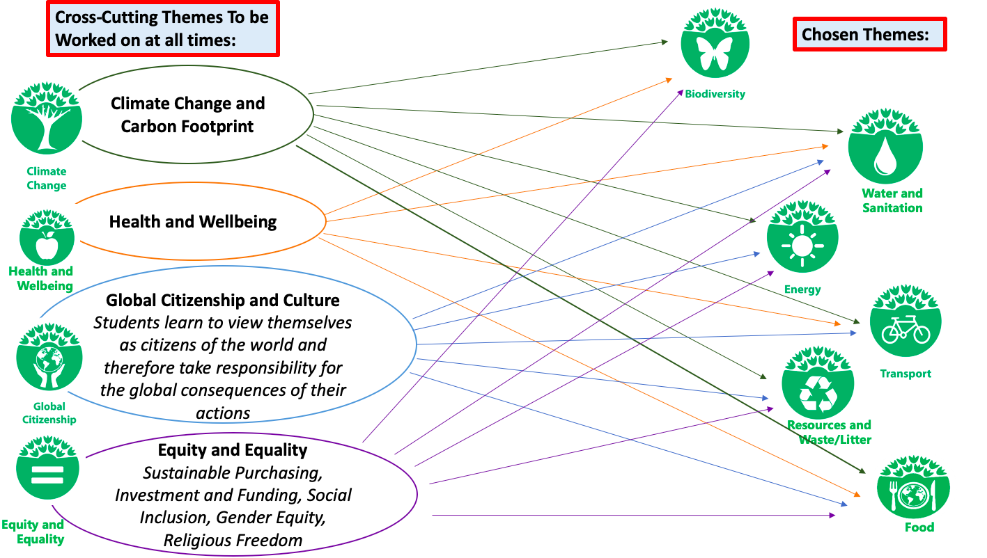
FEE EcoCampus Themes
… linked to SDGs!
FEE ECOCAMPUS
Notes:
These are the main Themes that ES International recommends should be included in the Environmental Review, many countries have others or slightly differently named Themes.
The FEE EcoCampus programme embraces the four crosscutting themes Climate Change and Carbon Footprint, Health and Wellbeing, Global Citizenship and Culture and Equity and Equality. These themes are crosscutting as they each are affected by and effect both each other AND the themes: Biodiversity, Water and Sanitation, Energy, Transport, Waste & Resources, and Food. Therefore, when choosing themes, FEE expects the campuses to view each theme from the perspective of how it links to the crosscutting themes and perhaps also other variable themes e.g. energy may link to water as energy is needed for water pumps, water heating and water cooling.
The institution should aim to embed the themes into relevant course curriculum, operations and governance as well as research targets of the institution. As your FEE EcoCampus programme progresses, Themes can be developed in detail, but it is important that the Seven Steps of the FEE EcoCampus programme becomes an intrinsic part of day-to-day operations on site. It is also vital for the longevity of the programme that the resources that are already in existence on site are utilized, for example the continuous management of older Themes like Waste, Energy, Water etc., before tackling a new Theme.
We encourage the campus to review the status of the management systems controls already in place in relation to the above listed Themes. Many organisations have personnel already dedicated to monitoring and controlling the items listed and may have targets and reduction programmes in place. In addition, certain course work may already be generating data such as Environmental Reviews and statistics, which may be useful.

Slide 17
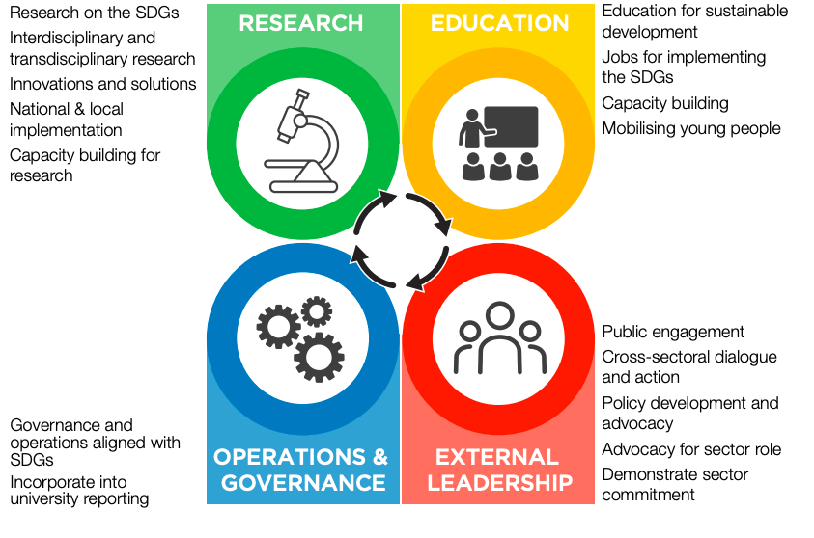
FEE EcoCampus and the Sustainable Development Goals
Universities need to become champions of sustainable development and play a leading role in the implementation of the SDGs.
From: SDSN: Getting Started with the SDGs in Universities
Engaging with the SDGs will also greatly benefit universities by helping them demonstrate university impact, capture demand for SDG-related education, build new partnerships, access new funding streams, and define a university that is responsible and globally aware.
FEE ECOCAMPUS
Notes:
FEE and its five programmes touch upon all 17 SDGs. Eco-Schools covers the SDGs within its Themes.

Slide 18
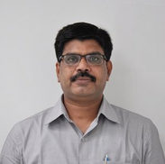
Contact us
Dr Pramod Kumar Sharma
Senior Director of Education
E: pramod@fee.global
T: +45 7022 2427
https://www.ecoschools.global/ecocampus-about
https://www.facebook.com/FEEEcoCampus
FEE ECOCAMPUS

